Slide 1
TABLE OF CONTENTS
Introduction
Objectives
Data Collection
Data Analysis:
Channel Usage Distribution
Signal Strength Distribution
Encryption Type Analysis
Band and Mode Analysis
Generation Analysis
Max Rate Distribution
Results and Discussion
Conclusion
Acknowledgments
References
Q&A

Slide 2
INTRODUCTION
Wi-Fi networks are essential for internet connectivity in homes, offices, and public spaces, supporting communication, productivity, and entertainment. Wi-Fi networks enable high-speed wireless access, fueling the growth of smart devices and the Internet of Things (IoT). Understanding Wi-Fi network characteristics is crucial for optimizing performance, ensuring reliability, and maintaining security. Factors to analyze include channel usage, signal strength, encryption types, bands, modes, generations, and max rates.

Slide 3
OBJECTIVES
Utilize Wi-Fi network data to gain insights into network performance, security, and potential areas for optimization.
Investigate key network attributes, including channel usage, signal strength, encryption types, bands, modes, generations, and max rates, to better understand their impact on overall network quality.
Uncover trends and patterns in the data that can inform decisions related to network improvements, security enhancements, and the most efficient use of available resources.

Slide 4
DATA COLLECTION
The WiFi Explorer tool is a software application that scans and analyzes wireless networks in real-time. It provides comprehensive information about nearby Wi-Fi networks, helping users monitor, troubleshoot, and optimize their Wi-Fi networks. The tool's functionality includes displaying network details, signal strength, channel usage, encryption types, and other relevant data, which can be exported in CSV(Comma-Separated Values) format for further analysis. Its capabilities make it an invaluable resource for network administrators, security professionals, and anyone interested in understanding and optimizing their Wi-Fi environment.

Slide 5
DATA COLLECTION
The collected data from the WiFi Explorer tool is stored in a CSV (Comma-Separated Values) file format, which is a widely-used, simple, and efficient way to store and exchange structured data. This format enables easy import and manipulation of the data in MATLAB or other data analysis tools. By using the CSV format, we can quickly load the Wi-Fi network information into MATLAB, where we can perform comprehensive analysis and visualization to understand the trends and patterns in the network characteristics, ultimately helping us make informed decisions for network optimization and security.

Slide 6
DATA COLLECTION
The key variables included in the dataset, such as BSSID, Network Name, Vendor, Annotations, Signal Strength, Channel, Channel Width, Band, Mode, Generation, Security, Max Rate (Mbps), and Seen Date/Time. This will be illustrated in the upcoming slide.

Slide 7
Data Analysis - Channel Usage Distribution
Understanding channel usage is crucial for optimizing Wi-Fi network performance. Identifying congested channels can help network administrators make informed decisions when selecting channels for their Wi-Fi networks, minimizing interference and improving overall network performance.
The Method used to calculate and visualize channel usage distribution:
Extract the 'Channel' column from the dataset.
Count the number of networks using each unique channel.
Plot a bar chart with unique channels on the x-axis and the number of networks using each channel on the y-axis.
The bar chart provides a clear visual representation of the channel usage distribution, enabling us to identify congested channels and spot patterns or trends.

Slide 8
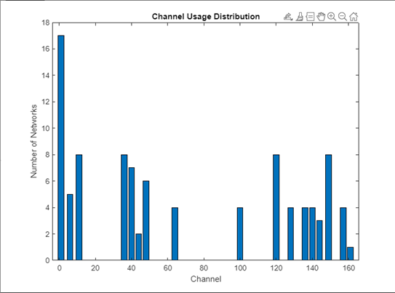
Data Analysis - Channel Usage Distribution

Slide 9
Data Analysis - Signal Strength Distribution
Signal strength directly impacts the quality of a Wi-Fi connection. Stronger signals provide better connectivity, faster data transfer rates, and lower latency. Analyzing signal strength distribution helps identify weak signals, potential areas of interference, and opportunities to optimize network performance.
The Method used to calculate and visualize signal strength distribution:
Extract the 'Signal___' column from the dataset, which represents signal strength in dBm.
Group the data by encryption types to analyze signal strength differences among various security configurations.
Plot a histogram for each encryption type, displaying signal strength on the x-axis and the number of networks on the y-axis.
The histograms provide a clear visual representation of signal strength distribution for each encryption type, enabling us to identify trends and compare the performance of different security configurations.

Slide 10
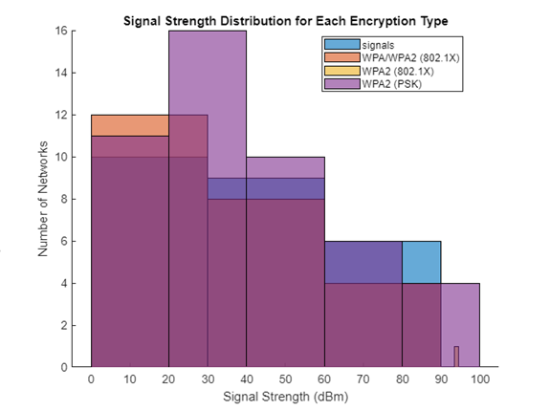
Data Analysis - Signal Strength Distribution

Slide 11
Data Analysis - Encryption Type Analysis
Encryption is crucial for ensuring the security and privacy of data transmitted over Wi-Fi networks. Different encryption types offer varying levels of protection against unauthorized access and data interception. Analyzing the proportion of networks using each encryption type can provide insights into the overall security landscape of the Wi-Fi networks in the area.
The Method used to calculate and visualize encryption type analysis:
Extract the 'Security' column from the dataset, which represents the encryption type of each network.
Calculate the number of networks using each unique encryption type.
Compute the percentage of networks using each encryption type relative to the total number of networks.
Create a pie chart to visualize the proportion of networks with different encryption types.
The pie chart provides a clear representation of the distribution of encryption types, allowing us to identify the most commonly used encryption methods and assess the overall security of the networks.

Slide 12
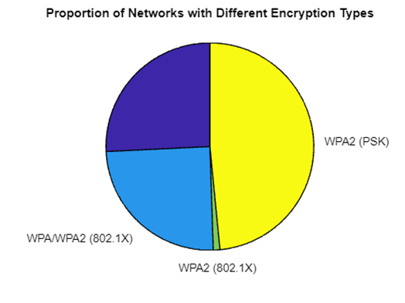
Data Analysis - Encryption Type Analysis

Slide 13
Data Analysis - Band and Mode Analysis
Bands and modes determine the frequency and data rates at which Wi-Fi networks operate. Understanding the distribution of bands and modes can provide insights into network performance, interference, and capacity. Analyzing these factors can help network administrators optimize their network settings for better performance and user experience.
The Method used to calculate and visualize band and mode analysis:
Extract the 'Band' and 'Mode' columns from the dataset, representing the bands and modes of each network.
Calculate the number of networks using each unique band and mode.
Compute the percentage of networks using each band and mode relative to the total number of networks.
Create two separate pie charts to visualize the proportion of networks with different bands and modes.
The pie charts provide a clear representation of the distribution of bands and modes, allowing us to identify the most commonly used bands and modes, and assess the overall network performance and capacity.

Slide 14
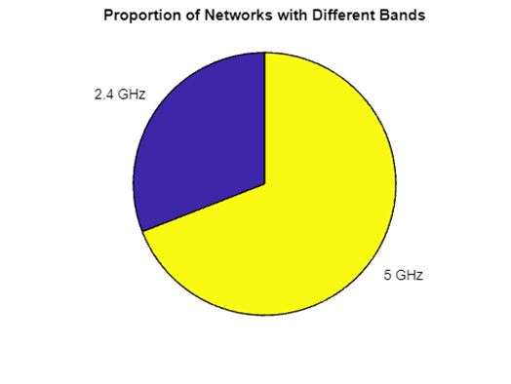
Data Analysis - Band Analysis

Slide 15
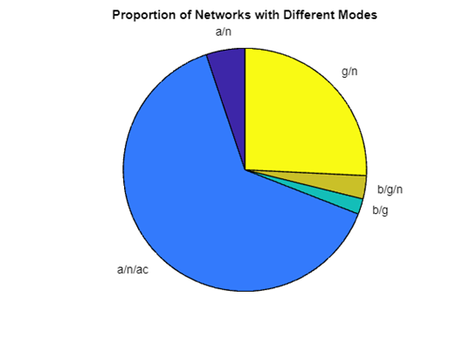
Data Analysis - Mode Analysis

Slide 16
Data Analysis - Generation Analysis
Generations represent the evolution of Wi-Fi technology, with each new generation offering improved speed, range, and reliability. Analyzing the distribution of generations can provide insights into the overall advancement of Wi-Fi networks in the area, and help identify potential bottlenecks or outdated technology. Understanding the generational distribution can aid network administrators and decision-makers in planning network upgrades and ensuring that users have access to the best possible Wi-Fi experience.
The Method used to calculate and visualize generation analysis:
Extract the 'Generation' column from the dataset, representing the generation of each network.
Calculate the number of networks in each unique generation.
Compute the percentage of networks in each generation relative to the total number of networks.
Create a bar chart to visualize the proportion of networks in each generation.
The bar chart provides a clear representation of the distribution of generations, allowing us to identify the most common generations in use and assess the overall technological advancement of the Wi-Fi networks in the area.

Slide 17
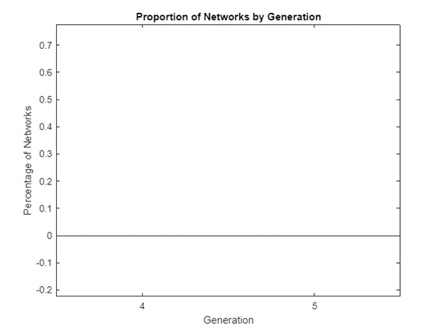
Data Analysis - Generation Analysis

Slide 18
Data Analysis - Max Rate Distribution
Max rate is an indicator of the potential speed a Wi-Fi network can offer to its users, which directly impacts user experience, especially for bandwidth-intensive tasks like streaming or large file transfers. Analyzing the distribution of max rates can help identify the overall quality and performance capabilities of Wi-Fi networks in the area. Understanding the distribution of max rates can assist network administrators and decision-makers in optimizing network performance and identifying potential areas for improvement or upgrades.
The Method used to calculate and visualize max rate distribution:
Extract the 'MaxRate_Mbps_' column from the dataset, representing the maximum rate of each network in Mbps (Megabits per second).
Create a histogram to visualize the distribution of max rates.
The histogram uses the Freedman-Diaconis rule to determine the number of bins, ensuring an optimal representation of the data.
The resulting histogram provides a clear visual representation of the max rate distribution, allowing us to assess the overall performance capabilities of the Wi-Fi networks in the area and identify potential areas for improvement.
Notes:
The Freedman-Diaconis rule is a method for determining the optimal number of bins to use when creating a histogram. It is particularly useful when analyzing data with unknown or irregular distribution patterns. The rule takes into account the sample size and the spread of the data to create a histogram that is neither too coarse nor too detailed.

Slide 19
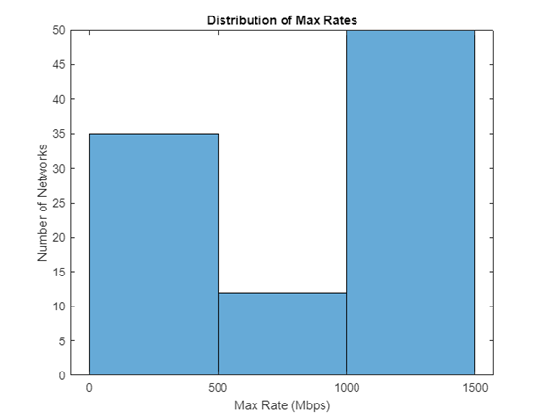
Data Analysis - Max Rate Distribution
Notes:
The Freedman-Diaconis rule is a method for determining the optimal number of bins to use when creating a histogram. It is particularly useful when analyzing data with unknown or irregular distribution patterns. The rule takes into account the sample size and the spread of the data to create a histogram that is neither too coarse nor too detailed.

Slide 20
DISCUSSION
In this project, we analyzed various characteristics of Wi-Fi networks, including channel usage, signal strength, encryption types, bands, modes, generations, and max rates. The main findings from the data analysis are summarized as follows:
The channel usage distribution revealed that some channels were more congested than others, indicating the need for better channel allocation to minimize interference and improve network performance.
The signal strength distribution showed a fairly high signal strength for multiple encryption types. However, it is essential to consider the trade-offs between signal strength and security when selecting an encryption type for a Wi-Fi network.
The analysis of encryption types showed a mix of secure and less secure methods being used, emphasizing the importance of adopting up-to-date and robust encryption standards to enhance network security.
The examination of bands and modes revealed a diverse distribution, with networks operating on various frequency bands and employing different wireless modes. Understanding these distributions can help network administrators make informed decisions about network configurations to optimize performance and compatibility with various devices.

Slide 21
DISCUSSION
The generation analysis provided insights into the adoption of different Wi-Fi generations in the sampled networks, highlighting the need for network administrators to ensure their networks are up-to-date with the latest technologies to maintain compatibility and performance.
The max rate distribution showed a wide range of values, suggesting that network administrators need to consider multiple factors, such as the number of users, network capacity, and required data rates, when configuring their networks to achieve optimal performance.
These findings have significant implications for network optimization and security decisions. By understanding the trends and patterns in Wi-Fi network characteristics, network administrators can make informed choices about channel allocation, encryption standards, band and mode selection, Wi-Fi generation, and max rate configurations. This, in turn, can lead to improved network performance, enhanced security, and better overall user experience.

Slide 22
CONCLUSION
In conclusion, this project analyzed and visualized Wi-Fi network data to gain insights into various network characteristics, including channel usage, signal strength, encryption types, bands, modes, generations, and max rates. The analysis revealed several key findings, such as the distribution of networks across different channels, the prevalence of certain encryption types, and the impact of newer generations on network performance and capabilities.
These findings are significant for network administrators and users alike, as they can inform decisions related to network optimization, performance improvement, and security enhancement. By understanding the current state of Wi-Fi networks in the area, administrators can make informed decisions to optimize channel usage, enhance signal strength, and select the most secure encryption types. Furthermore, staying up-to-date with the latest generations and technologies will help ensure the highest level of network security and performance.
Overall, this project demonstrates the value of analyzing Wi-Fi network data to gain a deeper understanding of network characteristics and their implications for network optimization and security. As technology continues to advance, it is essential for network administrators and users to stay informed about the latest trends and developments in the field, ensuring the best possible performance, user experience, and security for their Wi-Fi networks.

Slide 23
REFERENCES
[1] Wi-Fi Alliance. (n.d.). Wi-Fi Generations. Retrieved from https://www.wi-fi.org/discover-wi-fi/wi-fi-generations
[2] MathWorks. (n.d.). MATLAB Documentation. Retrieved from https://www.mathworks.com/help/matlab/
[3] Cisco Systems Inc. (n.d.). Understanding Wi-Fi Network Security. Retrieved from https://www.cisco.com/c/en/us/solutions/small-business/resource-center/networking/understanding-wi-fi-network-security.html
[4] IEEE 802.11 Working Group. (n.d.). IEEE 802.11 Wireless Local Area Networks. Retrieved from https://www.ieee802.org/11/
[5] Rappaport, T. S. (2002). Wireless Communications: Principles and Practice, 2nd Edition. Prentice Hall PTR.
[6] Gast, M. (2005). 802.11 Wireless Networks: The Definitive Guide, 2nd Edition. O'Reilly Media.
[7] Goldsmith, A. (2005). Wireless Communications. Cambridge University Press.
[8] Haykin, S., & Moher, M. (2004). Modern Wireless Communications. Prentice Hall.
[9] Molisch, A. F. (2010). Wireless Communications, 2nd Edition. Wiley-IEEE Press.
[10] Stallings, W. (2017). Wireless Communications & Networks, 2nd Edition. Pearson Education.
[11] Kurose, J. F., & Ross, K. W. (2016). Computer Networking: A Top-Down Approach, 7th Edition. Pearson.
[12] Dean, T. (2012). Network+ Guide to Networks, 6th Edition. Cengage Learning.

Slide 24
Q&A

